Slide 1

WELCOME!

Slide 2
Wednesday,September 18th, 2024.

Slide 3
Introduction
My name is_____.
I am ____ years old.
My favorite color is____.
My favorite food is ____.
I am a/an ____.

Slide 4

Common greetings
* Goodbye!
* Bye!
* See you!
* Have a nice…
* Good morning!
* Good afternoon!
* Good evening!
* Good night!
* How are you?
- Fine, thanks.
* Nice to meet you!
* What´s up?

Slide 5
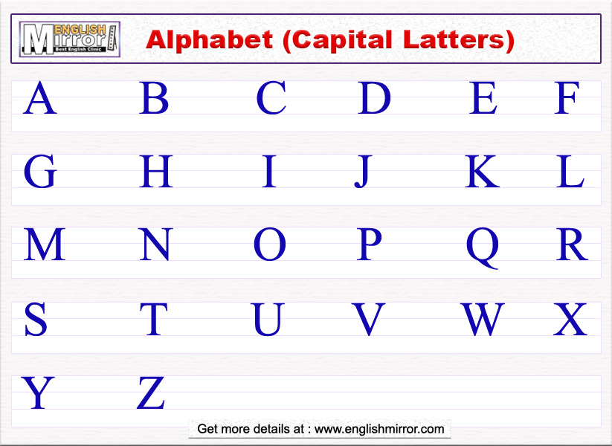



01
OVERVIEW
You can enter a subtitle here if you need it

Slide 6
Dictation
1. 11.
2. 12.
3. 13.
4. 14.
5. 15.
6.
7.
8.
9.
10.

Slide 7
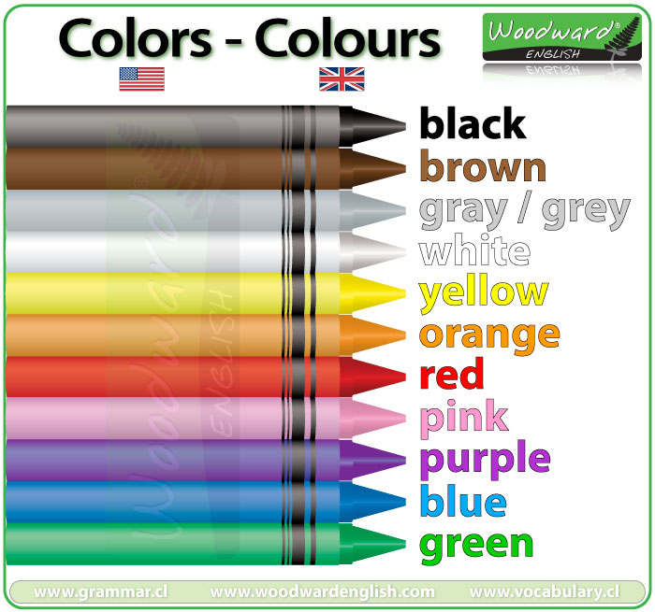

Slide 8
What is your favorite color?
My favorite color is ______
It´s ______
My favorite colors are ____ and

Slide 9
Vocabulary
1. teacher
2. classroom
3. school
4. notebook
5. environment

Slide 10
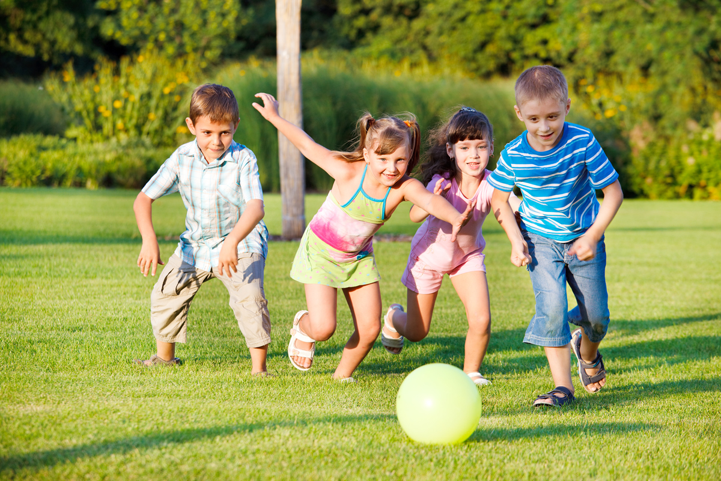
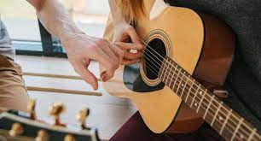
Verb play

Slide 11
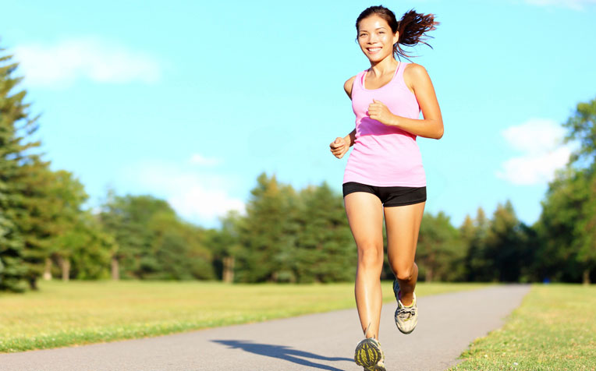
Verb run

