Slide 1
WELCOME!

Slide 2
Monday,September 23rd, 2024.

Slide 3
Introduction My name is_____. I am ____ years old. My favorite color is____. My favorite food is ____. I am a/an ____.

Slide 4
Common greetings
* Goodbye! * Bye! * See you! * Have a nice…
* Good morning! * Good afternoon! * Good evening! * Good night! * How are you? - Fine, thanks. * Nice to meet you! * What´s up?

Slide 5
01
OVERVIEW
You can enter a subtitle here if you need it

Slide 6
Dictation 1. 11. 2. 12. 3. 13. 4. 14. 5. 15. 6. 7. 8. 9. 10.

Slide 7
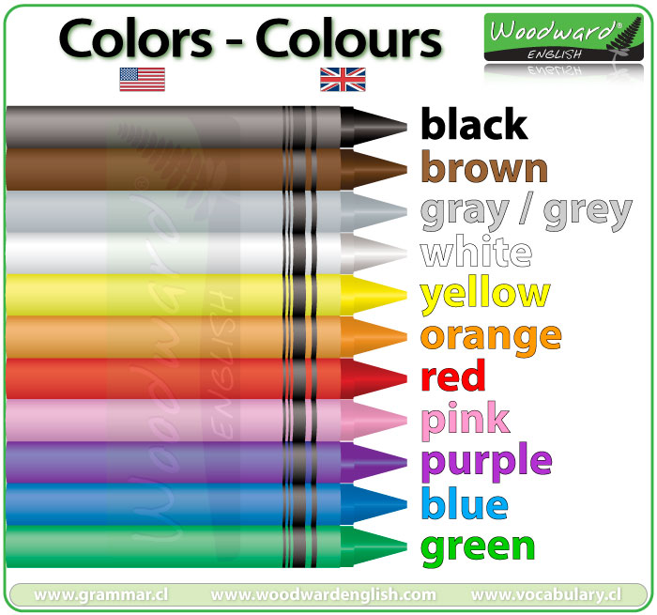

Slide 8
What is your favorite color? My favorite color is ______ It´s ______ My favorite colors are ____ and

Slide 9
Vocabulary 1. teacher 2. classroom 3. school 4. notebook 5. environment

Slide 10
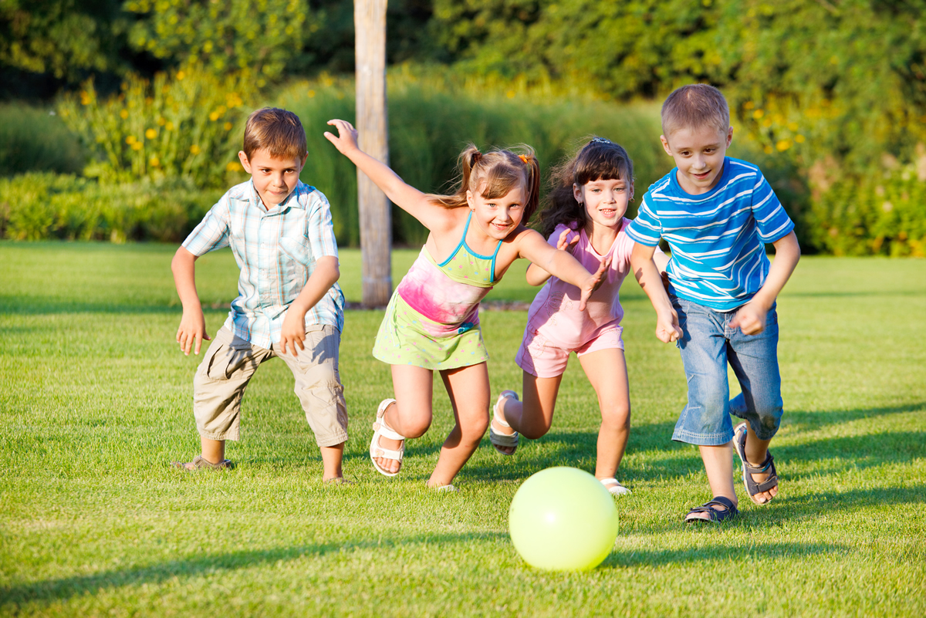
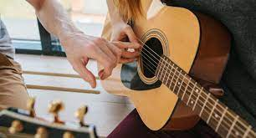
Verb play

Slide 11
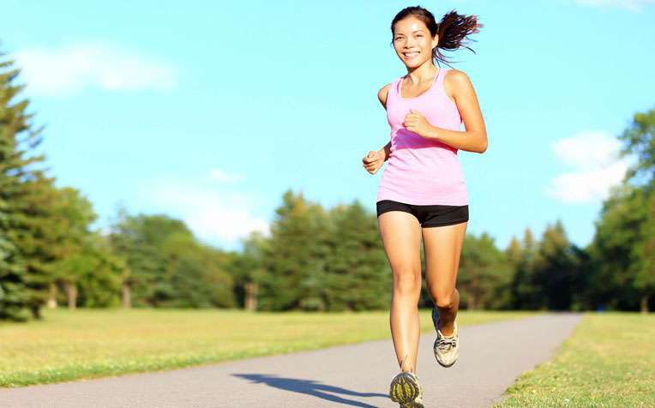
Verb run

