Slide 1
Good afternoon!

Slide 2
Thursday,September 26th, 2024.

Slide 3
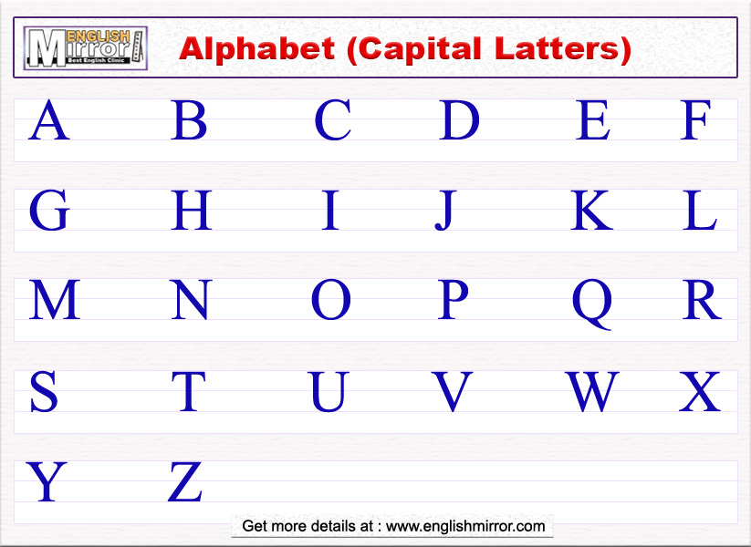



01
OVERVIEW
You can enter a subtitle here if you need it

Slide 4
Dictation
1.
2.
3.
4.
5.
6.
7.

Slide 5
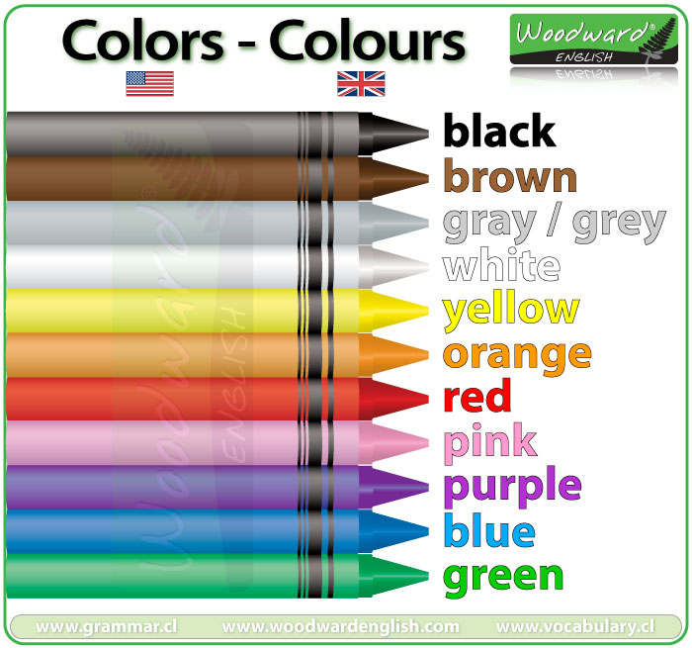

Slide 6
What is your favorite color?
My favorite color is ______
It´s ______
My favorite colors are ____ and

Slide 7
Vocabulary
1. accountant
2. student
3. table
4. amusement park
5. supermarket

Slide 8
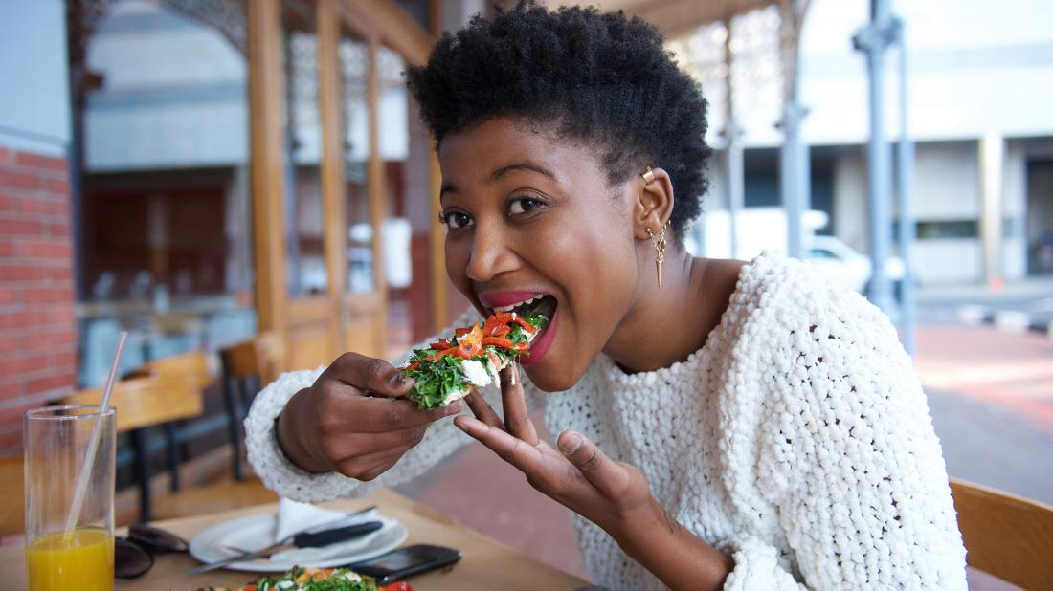
Verb eat

Slide 9
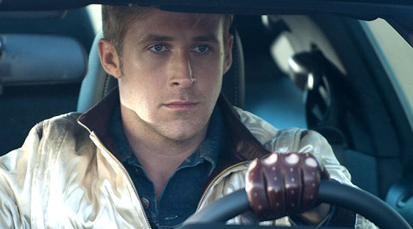
Verb drive

